Slide 1
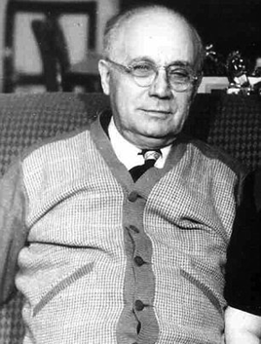
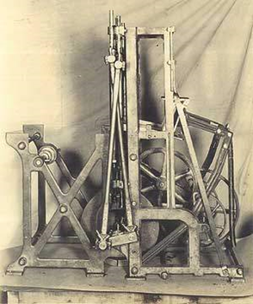
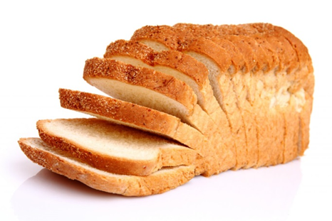
Otto Rohwedder
Notes:
Thanks to Paul Lord for this one…
Who is this? Otto Rohwedder. Okay, what is this? Bread slicing machine. Otto came up with the idea for a bread slicing machine in 1912. This is now considered the benchmark innovation in modern history, that thing against which all other ideas are measured.

Slide 2
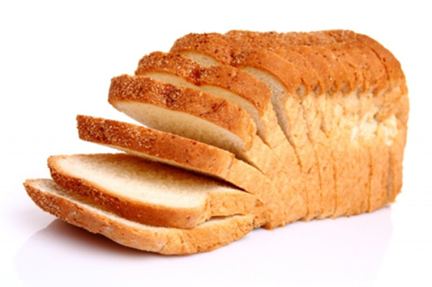
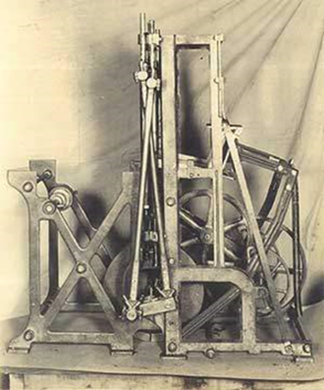
How long did it take for sliced bread to take off?
One year
Five years
Fifteen years
Fifty years

Slide 3
To AFFINITIE and beyond…
Robbie Foy
November 2017

Slide 4
To AFFINITIE and beyond…
Past
Present
Future

Slide 5
Audit and feedback
140 trials of audit and feedback median absolute improvement +4% interquartile range +1% to +16%
Ivers et al. Cochrane Database
of Systematic Reviews 2012
Notes:
Anyone do this?
It works a bit – but what makes it work better?

Slide 6
Audit and feedback
140 trials of audit and feedback median absolute improvement +4% interquartile range +1% to +16%
Larger effects if:
Baseline compliance low
Source a supervisor or colleague
Feedback provided more than once
Feedback delivered in both verbal and written formats
Feedback included both explicit targets and an action plan
Ivers et al. Cochrane Database
of Systematic Reviews 2012
Notes:
Anyone do this?
It works a bit – but what makes it work better?

Slide 7
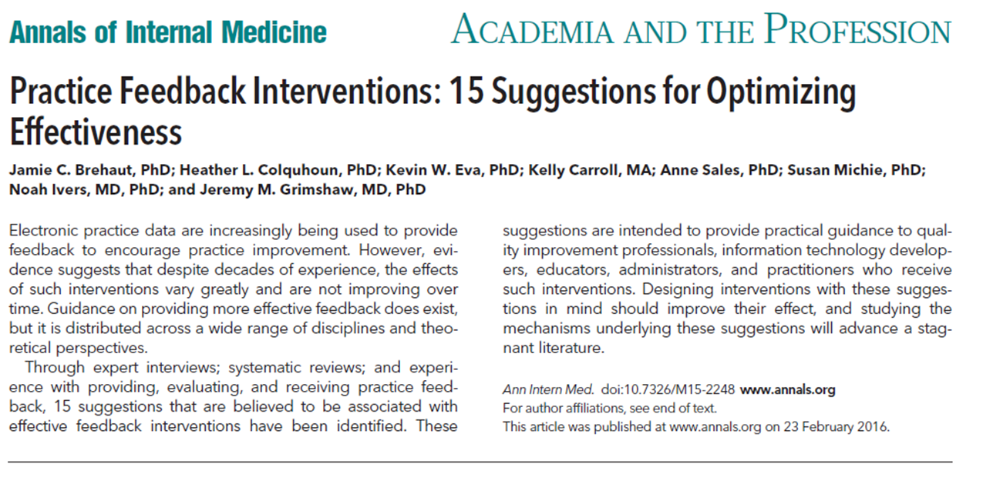
Suggestions for optimising the effectiveness of A&F

Slide 8
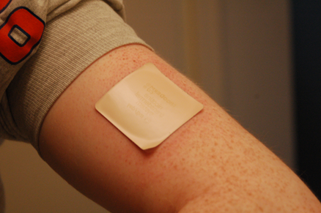
Suggestions for optimising the effectiveness of A&F
Nature of the desired action
Recommend actions that are consistent with established goals and priorities
Recommend specific actions
Recommend actions that can improve and are under the recipient's control

Slide 9
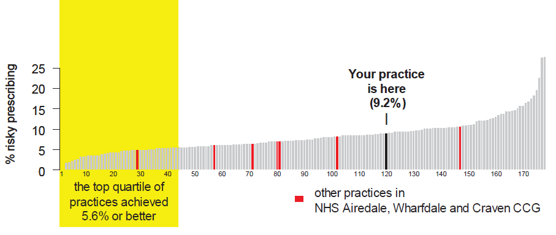
Suggestions for optimising the effectiveness of A&F
Nature of the data available for feedback
Provide multiple instances of feedback
Provide feedback as soon as possible and at a frequency informed by the number of new patient cases
Provide individual (e.g. practitioner specific) rather than general data
Choose comparators that reinforce desired behaviour change

Slide 10
Suggestions for optimising the effectiveness of A&F
Feedback display
Closely link the visual display and summary message
Provide feedback in more than one way
Minimize extraneous cognitive load for feedback recipients

Slide 11
Suggestions for optimising the effectiveness of A&F
Delivering the feedback intervention
Address barriers to feedback use
Provide short, actionable messages followed by optional detail
Address credibility of the information
Prevent defensive reactions to feedback
Construct feedback through social interaction

Slide 12
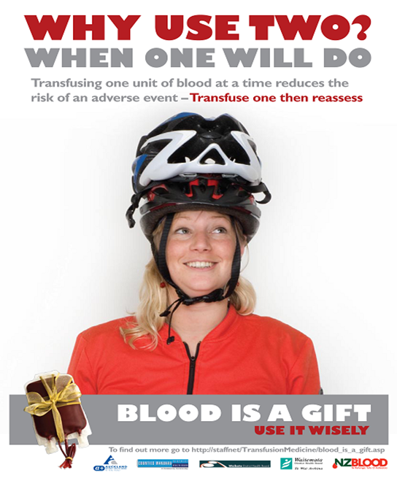
Enhanced audit and feedback interventions to increase the uptake of evidence-based transfusion practice
Stanworth S, Francis JJ, Foy R, Gould N, Lorencatto F, Farrin A, Hartley S, Morris S, Walwyn R, Grant-Casey J, Glidewell L, Cicero R, Deary A, Michie S, Murphy M
Notes:
An example of a laboratory

Slide 13
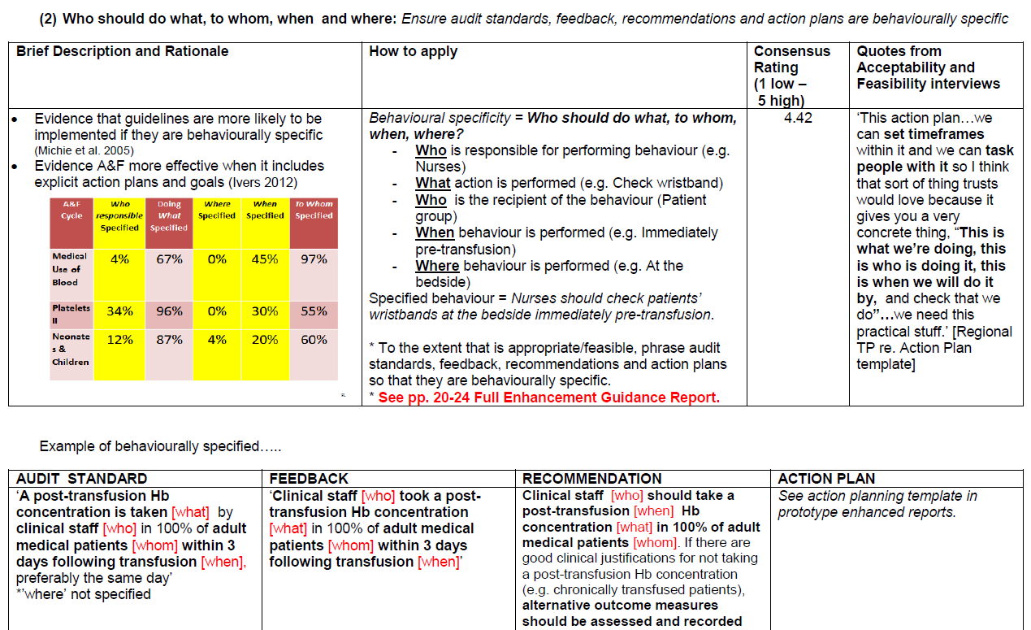
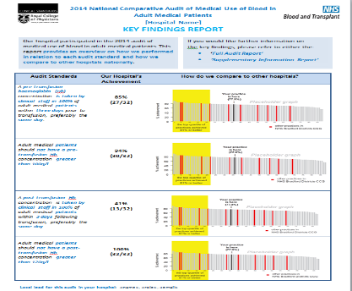
Intervention 1 ‘enhanced CONTENT’
Theory/Evidence informed enhancements
1. In each feedback report, include at least one BCT related to each component of Control Theory
2. Behaviourally specify audit standards, feedback, recommendations (i.e. Target/ Action/ Context/ Timeframe/Actor)
3. Only deliver feedback explicitly related to an audit standard
4. Include multiple comparators (i.e. national/ regional/ top 10%)
5. If feedback delivered once, conduct rapid re-audit comparing past/present behaviour
6. Include positive feedback (i.e. message of encouragement)
Enhancement guidance manual + template reports: audit writing group
Enhanced feedback reports:
transfusion clinical staff

Slide 16
Intervention 2 ‘enhanced FOLLOW ON SUPPORT’
Behaviour Change Techniques (n=20), including:
Instruction how to perform behaviour
Problem solving
Action planning
Goal-setting (behaviour/ Outcome
Self-monitoring
Behavioural practice/rehearsal
Demonstration of the behaviour
Social reward
Prompts and cues
Social support (practical)
Web-Toolkit
Telephone Support

Slide 17
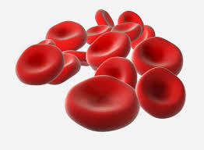
AFFINITIE Cluster RCT with 2x2 factorial design
UK Hospitals
Trial 1: Surgery
Baseline audit data: Appropriateness of transfusions
N= 155 Sites
Int delivered: Oct 15
Outcome Eval: Oct 16
Writing groups split
Randomisation
Standard Content + Standard Follow On
Enhanced Content + Standard Follow on
Standard Content
+
Enhanced Follow On
Enhanced Content + EnhancedFollow On
RE-RANDOMIZED BETWEEN TRIALS 1 +2
X
X
X
Trial 2: Haematology
N= 167 Sites
Int delivered: Jul 16
Outcome Eval: Jul17
Follow up audit data (12months): Appropriateness transfusions = outcome data

Slide 18
ENACT Enhancing clinical audit and feedback
Robbie Foy, Rebecca Walwyn, Jill Francis, Ben Brown, Fabiana Lorencatto, Natalie Gould, Amanda Farrin, Justin Keen, Jeremy Grimshaw, Jamie Brehaut, Noah Ivers, Justin Presseau, Heather Colquhoun, Simon Stanworth, Suzanne Hartley, Sarah Alderson, Roger Parslow & Chris Gale
Notes:
Foy introduction; and a study title desperately seeking an acronym

Slide 19
National audit partners

Slide 20
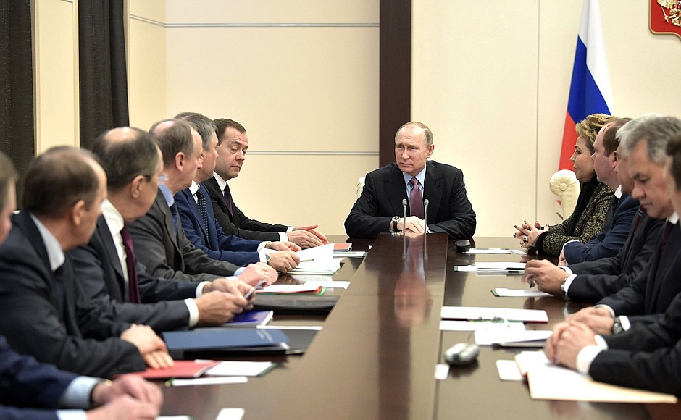
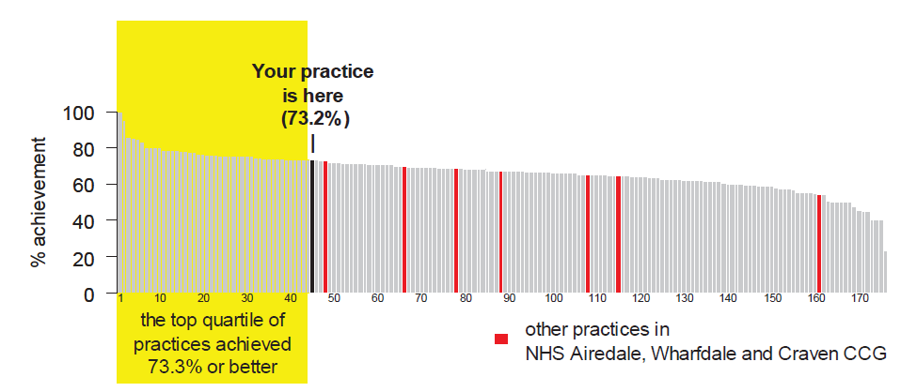
Develop and evaluate feedback modifications
Consensus to prioritise feedback modifications for testing
Online randomisation of 500 professionals targeted by four national audits
Responses to different combinations of feedback modifications through online portal
Identify the likely winners or winning combinations

Slide 21
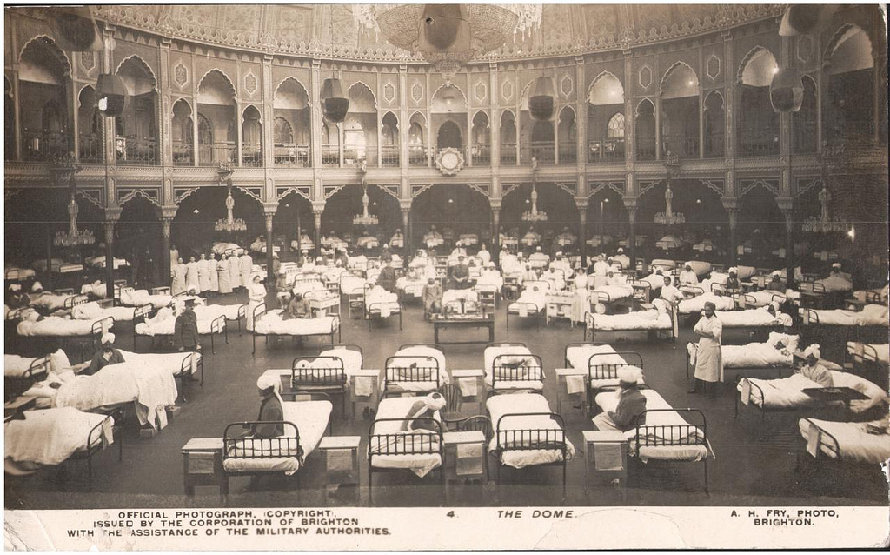
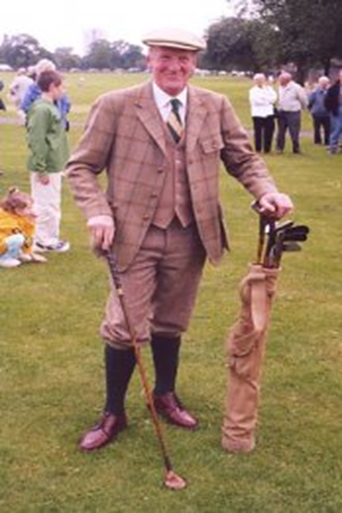
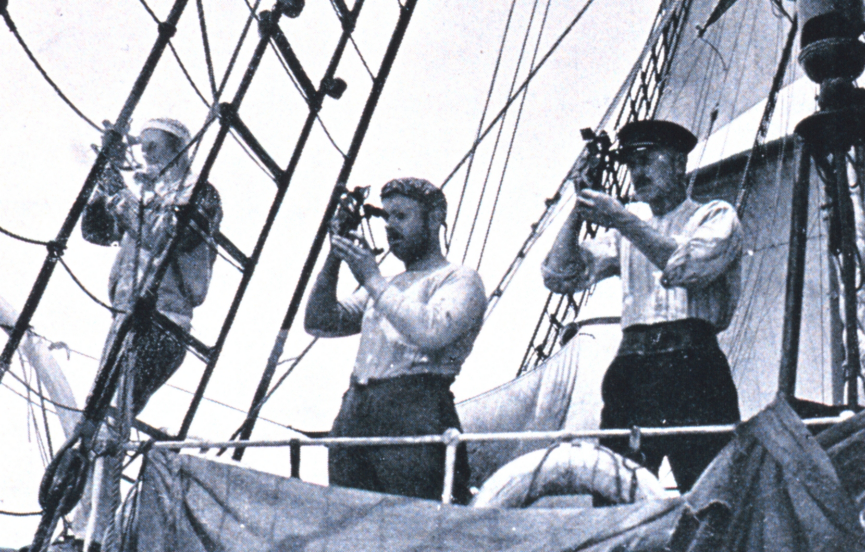
How healthcare organisations respond to feedback
Case studies of paired providers and commissioners
Observations, documentary analysis and interviews with board members, clinicians and managers
Analysis of how feedback is delivered, perceived and acted upon

Slide 22
Outputs
Practical suggestions for national audits to enhance impacts
A training manual and online resources to help organisations optimise the delivery and use of feedback

Slide 23
To AFFINITIE and beyond…
There is a growing evidence base…
… but further questions on how to enhance the impact of feedback
We can embed rigorous evaluations within national audits

Slide 24
Acknowledgement
This presentation summarises independent research funded by the National Institute for Health Research (NIHR) under its Programme Grants for Applied Research programme (Grant Reference Number RP-PG-1210-12010) and under its Health Services & Delivery Research Programme (Project:16/04/13)
The views expressed are those of the authors and not necessarily those of the NHS, the NIHR or the Department of Health

