Slide 1
PICANet Training
An introduction to recording the
Admission Dataset

Slide 2
What is PICANet?
A clinical audit database recording details of paediatric critical care in the United Kingdom and Republic of Ireland
Data is collected about referrals for paediatric intensive care, transport by a PCC CTS and admissions to a paediatric intensive care unit
The annual PICANet clinical audit report provides data about paediatric critical care which took place over a three year period

Slide 3
PICANet data is used to…
Identify best clinical practice
Monitor supply and demand
Review outcomes of treatment episodes
Facilitate healthcare planning and resource requirements
Study the epidemiology of critical illness in children

Slide 4
What do I need to know ?
Understand the process in your own unit for obtaining, recording, and entering data on PICANet Web
Understand the timelines for data submission
Understand why data quality is important
Understand and be familiar with the PICANet Admission Dataset Definitions, and the Referral & Transport Dataset Definitions (where appropriate). Copies can be downloaded from www.picanet.org.uk
Understand how to request access to PICANet Web

Slide 5
Obtaining, recording, and entering data on PICANet Web

Slide 6
Process of submission
There are two modes of submission for
uploading data to PICANet Web.
manual data entry – data is recorded on a data collection form or extracted from an electronic system
ii) imported from another database

Slide 7
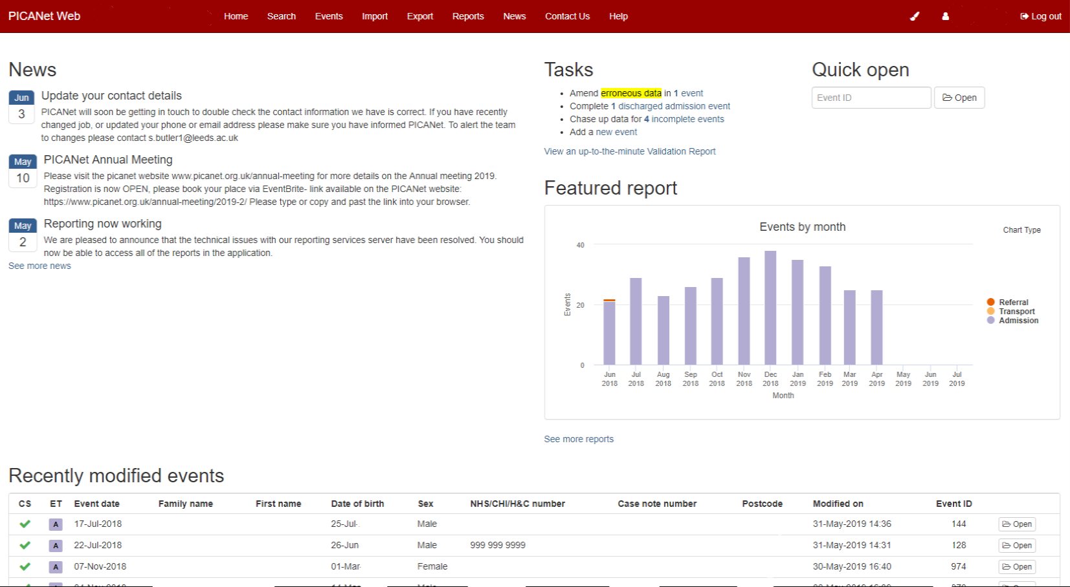
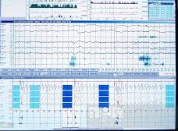
Data collection in PICU
Manual data entry to PICANet Web
Paper notes / charts and Transport documentation
PICANet admission, referral & transport form or in-house form
IMPORTED to PICANet Web
Electronic notes & charts

Slide 8
What data is required and why?
The PICANet Admission Dataset records:
Admission details – tracking of children throughout their paediatric intensive care stay, matching events for the same child, epidemiological analysis, assessment of health service delivery.
PIM3 data – the Paediatric Index of Mortality 3 score is calculated for every child admitted to PICU assessing severity of illness and risk of death to predict mortality.
Daily Interventions or PCCMDS (Paediatric Critical Care Minimum Dataset) - shows the care received by a child during each day in PICU. Allows calculation of the HRG grouping of level of care.
Primary Diagnosis, Operations & Procedures, Co-morbidities, and Discharge details Information - clinical audit, epidemiology, health service delivery.

Slide 9
How to complete the admission form
Guidance about completing the PICANet Admission event data is shown in the next 5 steps. In brief they are:
Step 1: Establish the admission details and record
Step 2: Record PIM data
Step 3: Record daily interventions (PCCMDS) data
Step 4: Record the diagnosis, operations and procedures
Step 5: Record discharge information

Slide 10
Step 1. Establish the Admission Details
It is important to confirm the source of admission to PICU because it identifies the source of data for completion of the PIM variables (see Step 2).
The source of admission to PICU may be from the:
Same hospital – transfer from another ward or department in the same hospital as the one housing your PICU
Other hospital – children retrieved/transferred directly from the original admitting hospital
Clinic or Home

Slide 11
Step 1. Establish the Admission Details
Same hospital - A&E, Other ward, theatre, HDU etc.
Use hospital notes
Complete
Date & Time of admission
Type of admission
Source of admission
Previous ICU admission
Care area admitted from
Retrieval/Transfer
Type of transport team
Transport Team name
Collection area
Where was the child receiving care prior to PICU admission?
Clinic or home
Other hospital
Use PIC Transport Team notes

Slide 12
Step 2. Recording PIM data for the admission dataset
PIM (Paediatric Index of Mortality) is a risk adjustment tool using physiological data from a child’s first contact with a PICU team to predict the risk of in PICU mortality for that patient.
It is calculated from the following variables:
Elective admission, main reason for PICU admission
surgical procedure, evidence available to assess past
medical history
Physiological measurements collected within the period
following first face to face contact between the child and
a specialist paediatric intensive care doctor and
up to one hour after admission.

Slide 13
2a. Source of admission – same hospital and recording PIM
PIM variables are recorded between the time of first face to face (not telephone) contact between the patient and a PIC specialist doctor to within one hour of PICU admission. Therefore it is important to record the precise time of admission to PICU.
This first contact may occur within the same hospital (e.g. A & E or ward), and it is acceptable for the PIC specialist doctor to use this data for PIM if it is very recent. In cases of doubt record the earliest measurement that was current at time of first contact.

Slide 14
2b. Recording PIM data for a child retrieved/transferred to PICU
If a child is retrieved/ transferred to PICU from the original admitting hospital, by a centralised PCC transport team e.g. CATS or NWTS, then PIM data is obtained from the point of first contact between the patient and the specialist PIC Doctor/nurse practitioner from the transport team.
These observations are recorded by the PCC CTS and a copy of the transport documentation is photocopied and left on PICU following a retrieval.
In cases of doubt record the earliest measurement that was current at the time of first contact.

Slide 15
2c. PIM data collection examples
Child admitted from theatre & recovery at 21.20hrs. Systolic BP, pupil reaction, and blood gas measured at 21.30hrs. PIM data has been measured and recorded within the first hour of PICU admission.
Child admitted from theatre at 04.44hrs. Systolic BP, & pupil reaction recorded on admission; arterial blood gas taken at 06.04hrs. Unit record the Systolic BP & pupil reaction but arterial blood gas not measured within first hour of admission to PICU therefore not valid for PIM data.

Slide 16
2d. PIM data collection examples
PIC doctor called to A&E to see a child at 20:15hrs, accepts for admission to PICU. Admitted to PICU at 21:00hrs. First face to face contact in A&E at 20:15hrs Systolic BP & blood gas result available to PIC doctor in A&E are recorded for PIM.
A&E telephone PIC doctor at 08:00hrs to discuss a child’s condition, PIC doctor accepts child for admission. Child admitted to PICU at 09.10. First face to face contact is at 09.10. SBP, pupil reaction, and blood gas measured and recorded for PIM within first hour of admission to PICU.

Slide 17
2e. PIM data collection examples
CTS (PCC) arrive at referring hospital at 15:00hrs, record SBP of 142/80 15:15hrs. First blood gas following arrival of PCC CTS is measured at 17.00hrs. Child admitted to PICU at 20.00hrs. This blood gas is not recorded as a PIM value for the transport team as it was taken more than one hour after the transport team arrival. However it could be recorded on PICU admission as being the earliest data available to the specialist PIC doctor in PICU and current at the time of first contact.
Transport team documentation may include a dedicated PIM box used by the teams to record the first face to face value measured within one hour of arrival at the bedside in the referring hospital
PIM values for transport event SBP 142mmHg Blood gas measured No Arterial PaO2 not valid Base Excess not valid Lactate not valid | PIM values for admission event SBP 142mmHg Blood gas measured Yes PaO2 5.5kPa Base Excess 0.5mmol/l Lactate -1.3mmol/

Slide 18
2f. PIM data further information
04:00 | 05:00 | 06:00 | 07:00 | 08:00 | 09:00 | 10:00 | 11:00 | 12:00 | 13:00 | 14:00 | 15:00 | 16:00
A | B |  | C |  |  | D | E
04:15 | A | CTS(PIC) team arrive at bedside - first face to face contact with child
05:15 | B | End of first hour for recording of Transport Event PIM data
07:30 | C | Depart referring hospital
10.00 | D | Arrive admitting PICU
11.00 | E | End of time period for recording Admission Event PIM data
Transport Event - PIM data applies to observations recorded in the first hour after first face to face contact with the transport team doctor or nurse
Admission Event - PIM data applies to the first face to face contact between the patient and the paediatric intensive care doctor to one hour after admission to your unit.

Slide 19
Step 3. Daily Interventions Paediatric Critical Care Minimum Data Set
Daily interventions record all interventions received by a child each day in a Paediatric Critical Care Unit
Applies to interventions received each calendar day (00:00 – 23:59) all interventions in a 24h period
must be recorded
For example:
Child is extubated at 00:30hrs on day 2 and commenced on non-invasive ventilation, then transferred to high flow nasal cannula therapy at 13:00hrs.
Invasive ventilation, non-invasive ventilation and HFNCT have all been delivered in that 24hr period – record all three respiratory interventions

Slide 20
Step 4. Recording the Diagnosis and Operations & Procedures
Record the primary diagnosis as assessed and recorded in the child’s notes, this may only be confirmed during the child’s stay and may not be obvious at admission
e.g. a child admitted with apnoea may have a later diagnosis confirmed as bronchiolitis. The primary diagnosis is bronchiolitis.
Where there are multiple primary diagnoses, discuss with a clinician and select just one as the primary diagnosis;
Record the second or subsequent diagnoses as “Other reasons for admission”

Slide 21
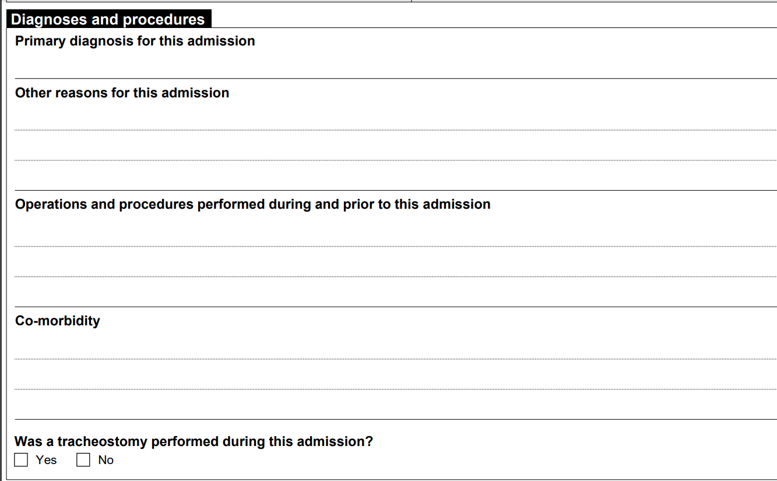
Step 4. Recording the Diagnosis and Operations & Procedures
Any operations and/or procedures performed during this admission to PICU, or during the current hospital spell and relating to this admission to PICU should be recorded

Slide 22
Step 5.Discharge information
The date and time of discharge is defined as the physical discharge and recording of that discharge from a bed or cot in your unit. This does not include temporary transfer (e.g. surgery) in the expectation of a return to your unit.
Date, time of death, and the mode of death are recorded for children who have deceased

Slide 23
Timelines for data submission

Slide 24
Meeting the PICS Standard for timely submission of event data to PICANet Web
Standard L3-702 of ‘The PICS Quality Standards for the Care of Critically Ill Children’ published in December 2015 states
‘The service should collect and submit Paediatric Intensive Care Audit Network (PICANet) data for submission to PICANet as soon as possible and no later than three months after discharge’ (this is currently under review)

Slide 25
Data quality and its importance

Slide 26
Checking Data Completion and Accuracy
It’s important to check the data your enter onto PICANet Web because:
Accurate and timely data enables effective epidemiological analysis, linking geographical and demographic information, tracing the delivery of care and treatment episodes to children through referral, retrieval, and admission. The data collected by PICANet is used not only to assess health care delivery but also facilitates health care planning and resource requirements.

Slide 27
Checking Data Completion and Accuracy
Confirm that all required Admission, Referral, and Transport Events are recorded on PICANet Web
Review your organisation's ‘live’ validation report to resolve any queries, missing data or errors.
PICANet Web provides the facility to run reports and export your organisations’ data to check numbers and confirm data accuracy

Slide 28
Validation of the data by the PICANet team
The PICANet Research Nurse undertakes a desk top review of the organisation’s data status every 6-8 weeks. An email is sent to units highlighting any outstanding issues
Validation visits are undertaken by PICANet staff approximately every 2 years
The organisation’s data is frozen on March 31st annually. The dataset is then cleaned prior to the publication of the Annual Report. Any queries requiring further review are returned to the owner organisation for checking

Slide 29
Access to PICANet Web

Slide 30
Named User Access to PICANet Web
All organisation staff requiring access to enter or download data from the PICANet Web record must have an individual user name and password. The sharing of user names and passwords is strictly banned
Requests for additional PICANet Web user access may be with written agreement from the designated PICANet Clinical Lead or the Unit Lead in the organisation
For new user access applications please email: picanetwebaccess@leeds.ac.uk

Slide 31
Dataset Definitions

Slide 32
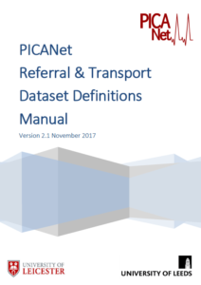
Dataset Definitions Manual
More detailed information is available in the Admission Dataset Definitions Manual and the Referral & Transport Dataset Definitions Manual. These are available at: www.picanet.org.uk

Slide 33
Where to go for help

Slide 34
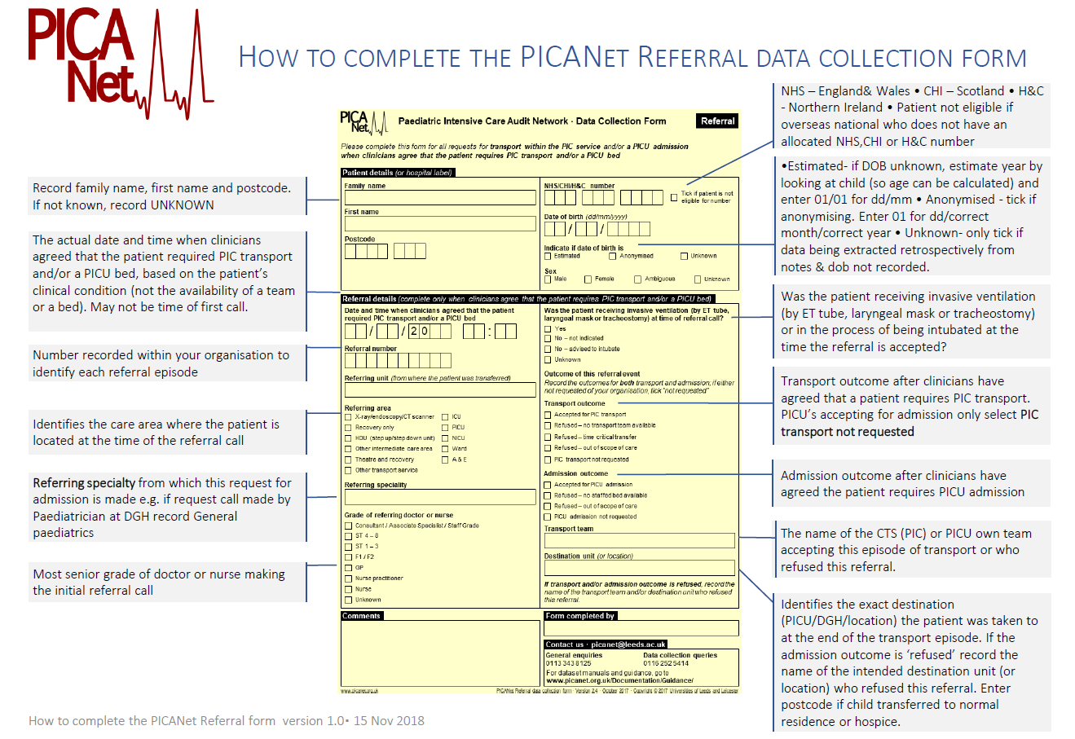
How to complete a data collection form
Step by step guidance on completing the Admission and Referral & Transport forms is available at
www.picanet.org.uk

Slide 35
The PICANet team may be contacted with any additional queries.
Please email picanet@leeds.ac.uk

